Slide 1


HIGH CLOUD AIRLINES
Group 2: Chaitanya Mokkapati Radhika Pramod Arekar Shalabh Bist
Shirisha Mandha
Yogesh Siddul
Jithesh K
Chettu Kiran Kumar

Slide 2
01
Company Description
CONTENTS
02
Business Problem
03
Data Challenges
04
Data Overview
05
Airlines Dashboard
06
Analysis & Suggestions

Slide 3

Company Description
High Cloud Airline is a young and ambitious airline company, committed to providing a seamless and comfortable travel experience for its passengers.
We pride ourselves on our modern fleet, cutting-edge technology, and focus on sustainability.
Our mission is to connect people and cultures, making the world a smaller place, one flight at a time.

Slide 4
Business Problem
In today's competitive airline industry, standing out from the crowd is crucial.
High Cloud Airline needs to understand its passengers better to personalize their travel experience and optimize its operations for profitability and efficiency.
Load Factor and Capacity Utilization
Analyze load factors and optimize capacity utilization for each flight.
Maximize revenue potential by adjusting capacity and pricing strategies.

Slide 5
KPIs
1.calcuate the following fields from the Orderdatekey field ( First Create a Date Field from Year , Month , Day fields)
A. Year
B. Monthno
C. Monthfullname
D. Quarter(Q1,Q2,Q3,Q4)
E. YearMonth ( YYYY-MMM)
F. Weekdayno
G. Weekdayname
H. FinancialMonth
I. Financial Quarter
2. Find the load Factor percentage on a yearly , Quarterly , Monthly basis ( Transported passengers / Available seats)
3. Find the load Factor percentage on a Carrier Name basis ( Transported passengers / Available seats)
4. Identify Top 10 Carrier Names based passengers preference
5. Display top Routes ( from-to City) based on Number of Flights
6. Identify the how much load factor is occupied on Weekend vs Weekdays.
7. Use the filter to provide a search capability to find the flights between Source Country, Source State, Source City to Destination Country , Destination State, Destination City
8. Identify number of flights based on Distance groups
9. Build a Dashboard to support your Analysis

Slide 6
Data Challenges
Missing data in source file like Airline ID, Origin State, Destination State
Table.import wizard not working in SQL for maindata_final.csv
Data Modelling using various sources
The challenge lies in integrating and analyzing this data effectively to extract actionable insights.
Utilize data visualization tools to explore trends and patterns in the data.

Slide 7
KPI 2
Load Factor Analysis – Yearly
Key Observation: In 2013, High Cloud Airlines achieved an exceptional load factor.
Load Factor Definition: Load factor measures the percentage of occupied seats on flights.
Significance:
High load factor indicates strong passenger demand and efficient capacity utilization. The high load factor in 2013 signifies robust demand and effective utilization of available seat capacity, contributing to High Cloud Airlines' operational success and revenue growth.
Business Implications: Increased revenue potential due to maximized seat occupancy.
Load Factor Analysis – Monthly
Significance:
Sustained high load factors (July) denote efficient capacity management and strong passenger demand.
Increased seat occupancy contributes to revenue maximization.
Conclusion:
The monthly load factor peaks reflect consistent success in maximizing seat occupancy, driving operational efficiency and revenue growth.

Slide 8
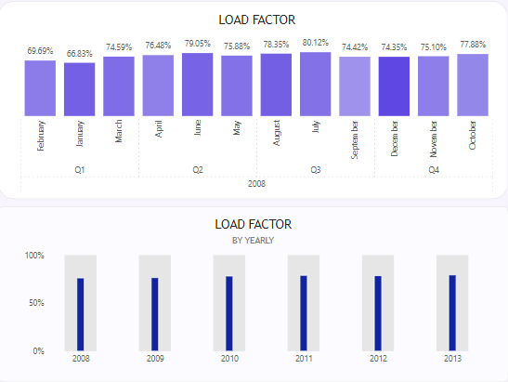
KPI 2
Load Factor Analysis – Quarterly
Key Observation: High Cloud Airlines achieved remarkable load factors in a particular quarter Q3.
Significance:
The high load factor in this quarter indicates efficient capacity utilization and strong passenger demand.
Increased seat occupancy positively impacts revenue generation.
Conclusion:
Quarterly Performance Highlight: The exceptional load factor in this quarter showcases operational excellence and revenue maximization for High Cloud Airlines.

Slide 9
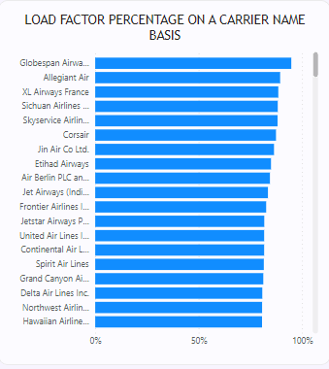
KPI 3
Load Factor Analysis by Carrier Name
Load Factor Percentage on a Carrier Name basis.
Calculation Formula: Load Factor = (Transported Passengers / Available Seats) * 100
Insights:
Higher the load factors indicate efficient capacity utilization and strong demand.
Globespan Airways limited d/b/d flyglobespan and Allegiant Air have high load factor as compare to Corporatesjets,XXI and Tradewinds Airlines
Conclusion:
Performance Evaluation: Load factor analysis by carrier name offers insights into each carrier's efficiency in maximizing seat occupancy and meeting passenger demand

Slide 10
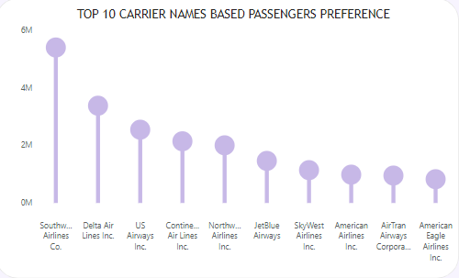
KPI 4
Top 10 Carrier names based on Passengers’ preference
Southwest Airlines Co.
Delta Air Lines Inc.
US Airways Inc.
Continental Air Lines Inc.
JetBlue Airways
AirTran Airways Corporation
SkyWest Airlines Inc.
American Airlines Inc.
American Eagle Airlines Inc.
Alaska Airlines Inc.

Slide 11
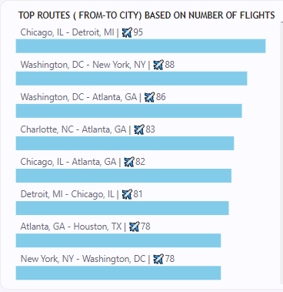
KPI 5
Top 10 routes based on number of flights Chicago, IL - Detroit, MI
Washington, DC - New York, NY
Washington, DC - Atlanta, GA
Charlotte, NC - Atlanta, GA
Chicago, IL - Atlanta, GA
Detroit, MI - Chicago, IL
New York, NY - Washington, DC
Atlanta, GA - Houston, TX
Minneapolis, MN - Chicago, IL
Atlanta, GA - Washington, DC

Slide 12
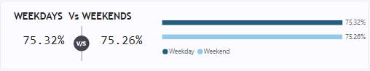
KPI 6
Load factor occupied on Weekend vs Weekdays
As per the analysis, more load factor is occupied on Weekdays in compare to Weekends.
Insights:
It shows slightly more people are travelling on weekdays. Business travelers are more in comparison to vacation travelers.
Careers are carrying more cargo goods on weekdays.

Slide 13
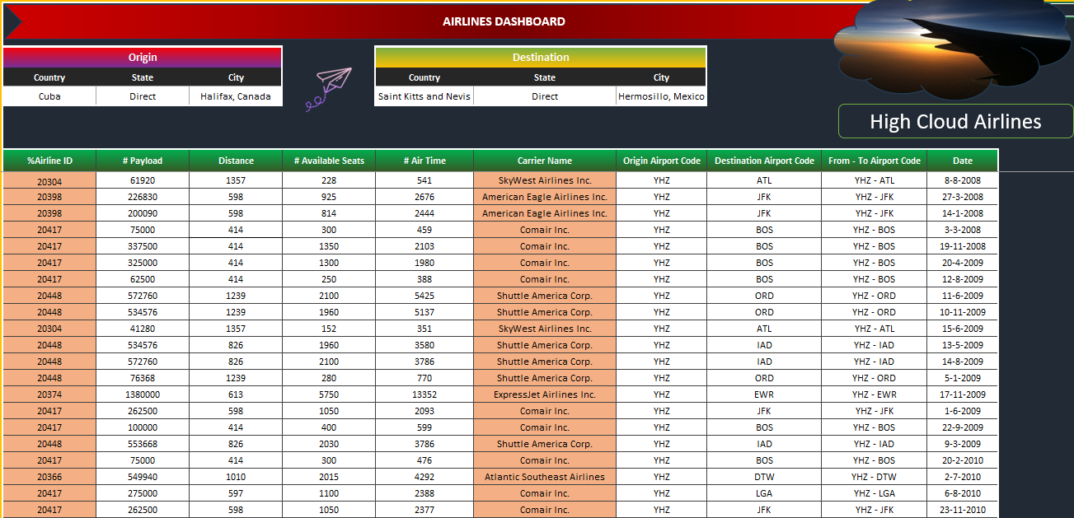
KPI 7

Slide 14
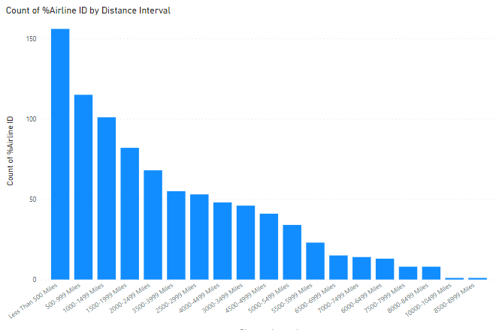
KPI 8
Number of flights based on Distance groups
High number of flights for
Less Than 500 Miles
500-999 Miles
1000-1499 Miles
1500-1999 Miles
Average number of flights for
2000-2499 Miles
3500-3999 Miles
2500-2999 Miles
4000-4499 Miles
3000-3499 Miles
4500-4999 Miles
5000-5499 Miles

Slide 15
KPI 8
Number of flights based on Distance groups
Low number of flights for
5500-5999 Miles
6500-6999 Miles
7000-7499 Miles
6000-6499 Miles
7500-7999 Miles
8000-8499 Miles
10000-10499 Miles
8500-8999 Miles

Slide 16
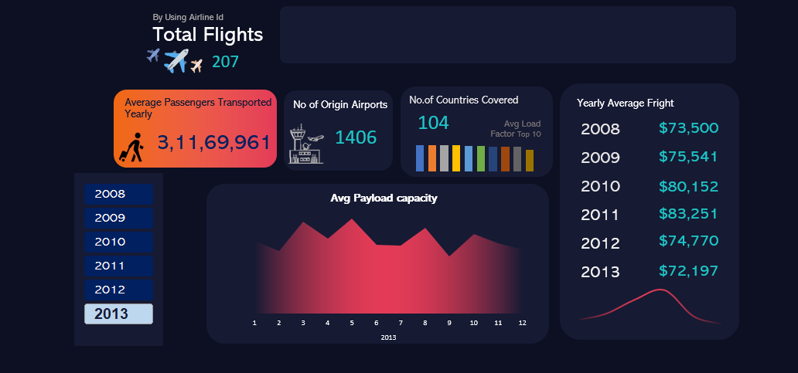
Airlines Dashboard

Slide 17
Suggestions
In today's competitive airline industry, standing out from the crowd is crucial.
High Cloud Airline needs to understand its passengers better to personalize their travel experience and optimize its operations for profitability and efficiency.
Increase the number of flights for longer distance travel i.e. 55000miles- 8999 miles.

Slide 18

THANK YOU

